Slide 1
Testing React Components

Slide 2

Pretest
What should you test?
How do you test asynchronous code? How do you do HTTP Requests in React?

Slide 3
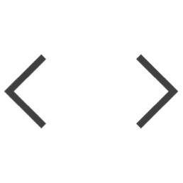



What Should Be Tested in a React Component?
Test the output
Test the states
Test the events
Test the edge cases

Slide 4
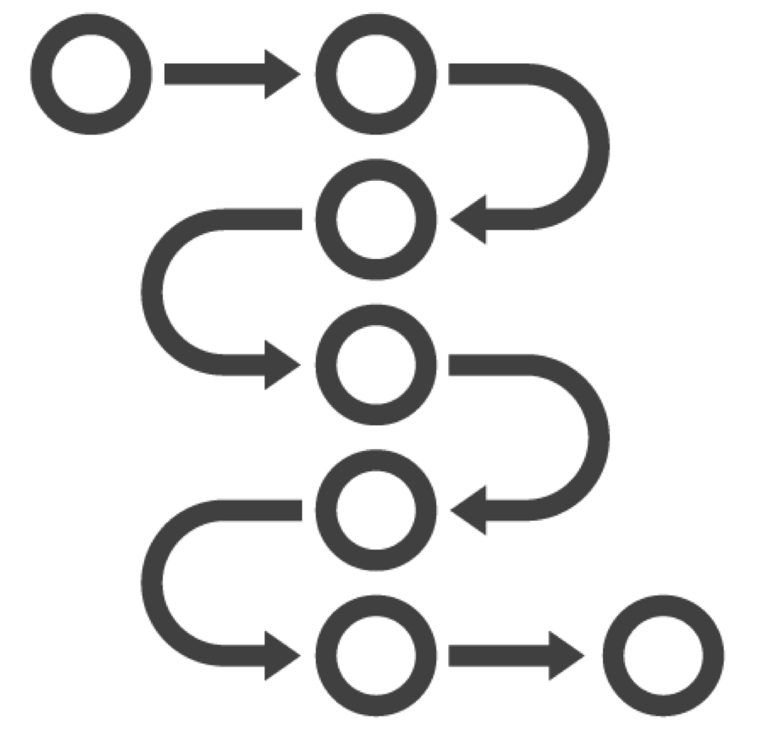
Pure Functions
Always return the same result given the same arguments
Don't depend on the state of the application
Don't modify the variables outside of their scope (no side effects)

Slide 5
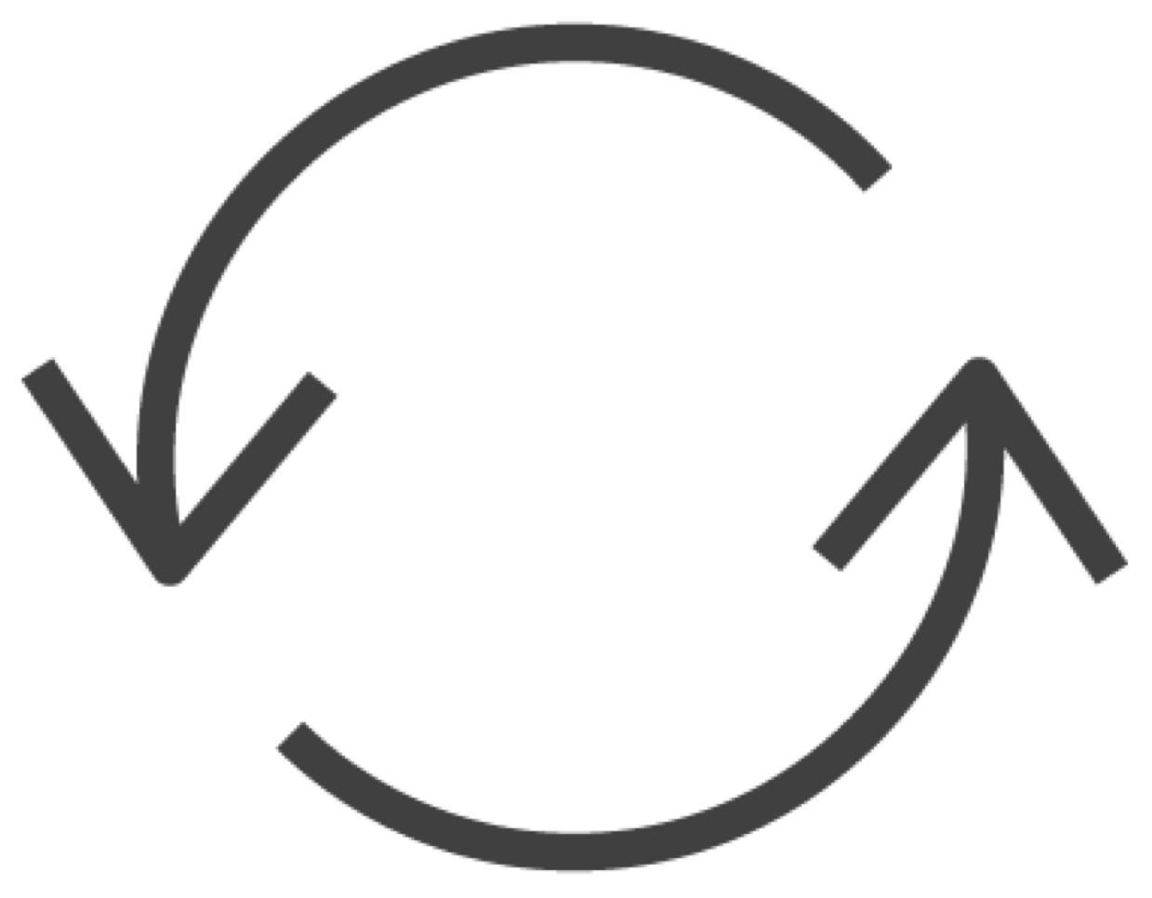
Lifecycle Methods
Mount / Unmount
constructor()
render()
componentDidMount()
componentWillUnmount()
Updating
shouldComponentUpdate()
render()
componentDidUpdate()

Slide 6
Demo
Create a Manual Module Mock

Slide 7
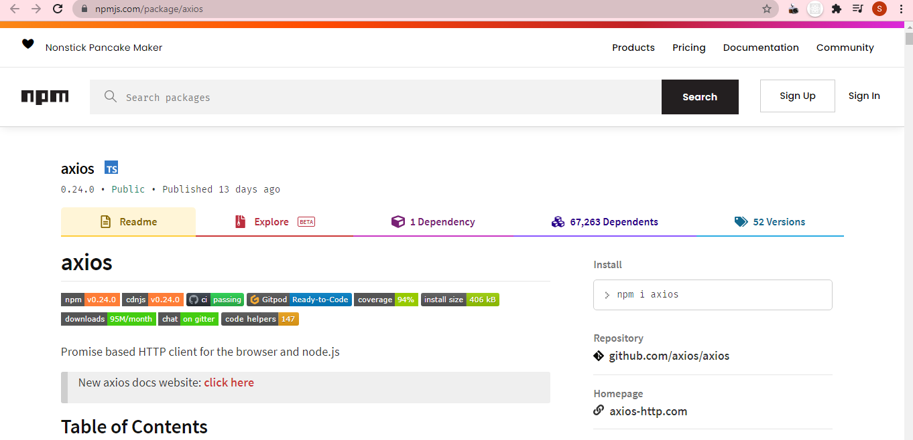

Slide 8
Demo
Write an Asynchronous Test

Slide 9
Demo
Test for State Updates in Response to AJAX requests

Slide 10
Summary
Using Lifecycle Methods
Making Ajax Requests in React Understanding Pure Functions Creating Test Mocks

